Slide 1

Introduction to
R is an open-source environment for statistical computing and visualization. It is the product of an active movement among statisticians for a powerful, programmable, portable, and open computing environment, applicable to the most complex and sophisticated problems, as well as “routine” analysis, without any restrictions on access or use.
  Performs a variety of simple and advanced statistical methods
  Produces high quality graphics
  R is a computer language so we can write new functions that
  extends R’s uses
  R was initially written by Ross Ihaka and Robert Gentleman at
  the University of Auckland in Auckland, New Zealand (hence
  the name). The official R home page is
  http://www.r-project.org

Slide 2
Introduction to
The R system can be installed on, Windows, Mac or Linux
You will want to install the base system.
In addition to the base system there are user contributed add-on packages. Packages are a collection of functions, examples and documentation that usually focus on a specific task.
The base system contains some packages. To install an additional package, say survival, be connected to the Internet and type
> install.packages(“car")
You will be asked to select the mirror site nearest to you, after that everything is automatic.
Before using the contents of the package we need to load it,
  > library(car)
See the R website for a complete list of contributed packages. As of 01/25/2025 there are 21931 different packages
https://cran.r-project.org/web/packages

Slide 3
R and Statistics
Packaging: a crucial infrastructure to efficiently produce, load and keep consistent software libraries from (many) different sources / authors
Statistics: most packages deal with statistics and data analysis
State of the art: many statistical researchers provide their methods as R packages

Slide 4
Variable names
Variable names in R are case sensitive so x is not the same as X
Variable names should not begin with numbers or symbols
Variable names should not contain blank space: use New.York (not New York)
R is CASE SENSITIVE
Getting Started

Slide 5
R Vectors
A series of numbers
Created with
  c()to concatenate elements or sub-vectors
  rep()to repeat elements or patterns
  seq()or m:nto generate sequences
Most mathematical functions and operators can be applied to vectors
Defining Vectors
> rep(1,10) # repeats the number 1, 10 times
[1] 1 1 1 1 1 1 1 1 1 1
> seq(2,6) # sequence of integers between 2 and 6
[1] 2 3 4 5 6 # equivalent to 2:6
> seq(4,20,by=4) # Every 4th integer between 4 and 20
[1] 4 8 12 16 20
> x <- c(2,0,0,4) # Creates vector with elements 2,0,0,4
> y <- c(1,9,9,9)
> x + y # Sums elements of two vectors
[1] 3 9 9 13

Slide 6
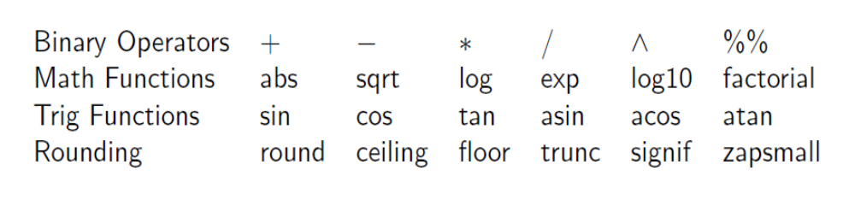
R as a calculator
Enter a math expression and the result is displayed to the console
NA is the code for missing data
R is CASE SENSITIVE

Slide 7
Character vectors
Scalars and vectors can be made up of strings of characters instead of numbers. All elements of a vector must be of the same type.
Ex:
> day=c("Sun","Mon","Tue","Wed","Thu","Fri","Sat")
> day
[1] "Sun" "Mon" "Tue" "Wed" "Thu" "Fri" "Sat"
>nchar()# coun the number of characters
There are some bult-in functions
> LETTERS
[1] "A" "B" "C" "D" "E" "F" "G" "H" "I" "J" "K" "L" "M" "N" "O" "P" "Q" "R" "S" "T" "U" "V" "W" "X" "Y" "Z"
> letters
[1] "a" "b" "c" "d" "e" "f" "g" "h" "i" "j" "k" "l" "m" "n" "o" "p" "q" "r" "s" "t" "u" "v" "w" "x“ "y" "z"
>

Slide 8
Combining character values
> month <- c("Apr", "Dec", "Jan")
> day <- c(3, 13, 23)
> year <- c(2001, 2009, 1997)
>
> date<- paste(year, month, day, sep="-")
> date
[1] "2001-Apr-3" "2009-Dec-13" "1997-Jan-23"
====================================
> paste("Q", 1:4, sep="")
[1] "Q1" "Q2" "Q3" "Q4"

Slide 9
Character vectors
Scalars and vectors can be made up of strings of characters instead of numbers. All elements of a vector must be of the same type.
There are two basic operations we might want to perform on
character vectors.
To take substrings, use substr()
To add additional information paste()
Example
> colors <- c("red", "yellow", "blue")
> substr(colors, 1, 2)
> paste(colors, "flower")
Also see
> paste0(colors, "flower") # reduces the space

Slide 10
sub function for characters
> a = "The dog ate my food"
> sub("dog","cat",a)
[1] "The cat ate my food"
> strsplit("abc", "")
[[1]]
[1] "a" "b" "c"

Slide 11
Coercion
All elements in a vectors must be of the same type.
• R coerces the elements to a common type, in this
>c(1.2, 3, TRUE) – In this case all elements are coerced to numeric, 1.2, 3, and 1.
> x = c(TRUE, FALSE, TRUE)
> c(1.2, x)
[1] 1.2 1.0 0.0 1.0
> y = c("2", "3", ".2")
> c(1.2, y, x)
[1] "1.2" "2" "3" ".2" "TRUE" "FALSE" "TRUE"
• Sometimes this coercion occurs in order to perform an arithmetic operation:
> 1 + x
[1] 2 1 2
• Other times we need to perform the coercion
> c(1.2, y)
[1] "1.2" "2" "3" ".2"
> c(1.2, as.numeric(y))
[1] 1.2 2.0 3.0 0.2

Slide 12
Lists
A vector with possible heterogeneous elements. The elements of a list can be numeric vectors, character vectors, matrices, arrays, and lists.
> data = list(a = 1:10, b = "definition", c(TRUE, FALSE, TRUE))
> data
$a
[1] 1 2 3 4 5 6 7 8 9 10
$b
[1] "definition"
[[3]]
[1] TRUE FALSE TRUE
> length(data)
[1] 3
> length(data)
[1] 3
> class(data)
[1] "list"
> names(data)
[1] "a" "b" ""

Slide 13
Accessing Vector Elements
Use the [ ] operator to select elements
  To select specific elements:
    - Use index or vector of indexes to identify them
  To exclude specific elements:
    - Negate index or vector of indexes
  Alternative:
  - Use vector of T and F values to select subset of elements
  > x <- c(2,0,0,4)
  > x[1] # Select the first element, equivalent to x[c(1)]
  [1] 2
  > x[-1] # Exclude the first element
  [1] 0 0 4
  > x[1] <- 3 ; x
  [1] 3 0 0 4
  > x[-1] = 5 ; x
  [1] 3 5 5 5

Slide 14
Reading EXCEL Files in R
readxl package comes with the function
read_excel() to read xls and xlsx files
library("readxl")
my_data <- read_excel("my_file.xls")
# xlsx files
my_data <- read_excel("my_file.xlsx")
my_data <- read_excel("my_file.xlsx", sheet = "data")
# Specify sheet by its index
my_data <- read_excel("my_file.xlsx", sheet = 2)

Slide 15
Reading text data into a R data.frame
The following high-level R functions allow you to read in data that is technically correct, or close to it.
read.delim read.delim2
read.csv read.csv2
read.table read.fwf
The return type of all these functions is a data.frame. If the column names are stored in the first line, they can automatically be assigned to the names attribute of the resulting data.frame.
Best practice: A freshly read data.frame should always be inspected with functions like head, str(for structure), and summary.

Slide 16
Reading data into a R data.frame
read.csv for comma separated values with period as decimal separator.
read.csv2 for semicolon separated values with comma as decimal separator.
read.delim tab-delimited files with period as decimal separator.
read.delim2 tab-delimited files with comma as decimal separator.
read.fwf data with a predetermined number of bytes per column
(use utils package)
###########################
write.csv It allows to create a .csv file of our data base
> var1 <- sample(5)
> var2 <- var1 / 10
> var3 <- c("R", "and", "Data Mining", "Examples", "Case Studies")
> df1 <- data.frame(var1, var2, var3)
> write.csv(df1, "C:\\Users\\aryalg\\Desktop\\data.csv")

Slide 17
Reading Data in R
Load from a text file using read.table()
Parameters header, sep, and na.strings control useful options
read.csv()and read.delim()have useful defaults for comma or tab delimited files
Consider the bp.txt data which is as below
HEIGHT WEIGHT WAIST HIP BPSYS BPDIA
172 72 87 94 127.5 80
166 91 109 107 172.5 *
174 80 95 101 123 64
Read into R using:
bp<-read.table(“bp.txt”,header=T,na.strings=“*”)

Slide 18
Accessing Data Frames/Subsetting
Multiple ways to retrieve columns
>bp<-read.table(“bp.txt”,header=T,na.strings=“*”)
The following all options will retrieve the weight data from the
> bp[“WEIGHT”]
> bp[,2]
> bp$WEIGHT
Also it can be accessed by attaching the data
>attach(bp)
>WEIGHT

Slide 19
Type Conversion
Converting a variable from one type to another is called coercion. The reader is probably familiar with R's basic coercion functions, but as a reference they are listed here.
as.numeric as.logical
as.integer as.factor
as.character as.ordered

Slide 20
String normalization
Similarly, strings can be padded with spaces or other characters with str_pad to a certain width. For example, numerical codes are often represented with prepending zeros.
>library(stringr)
>str_pad(112, width = 6, side = "left", pad = 0)
[1] "000112"
Converting strings to complete upper or lower case can be done with R's built-in to upper and tolower functions.
>toupper("Hello world")
## [1] "HELLO WORLD"
>tolower("Hello World")
## [1] "hello world"

Slide 21
Rstudio (www.rstudio.com)
The RStudio interface consists of several main components sitting
below a top-level toolbar and menu bar. Although this placement
can be adjusted, the default layout utilizes four main panels or
panes in the following positions:
  In the upper left is a R script editor for editing files or viewing
some data sets.
  In the lower left is a Console for interacting with an R process
  In the upper right is a notebook widget to hold a Workspace
browser and History browser
  In the lower right is a notebook to hold tabs for interacting
with the Files, Plots, Packages and Help system components

Slide 22
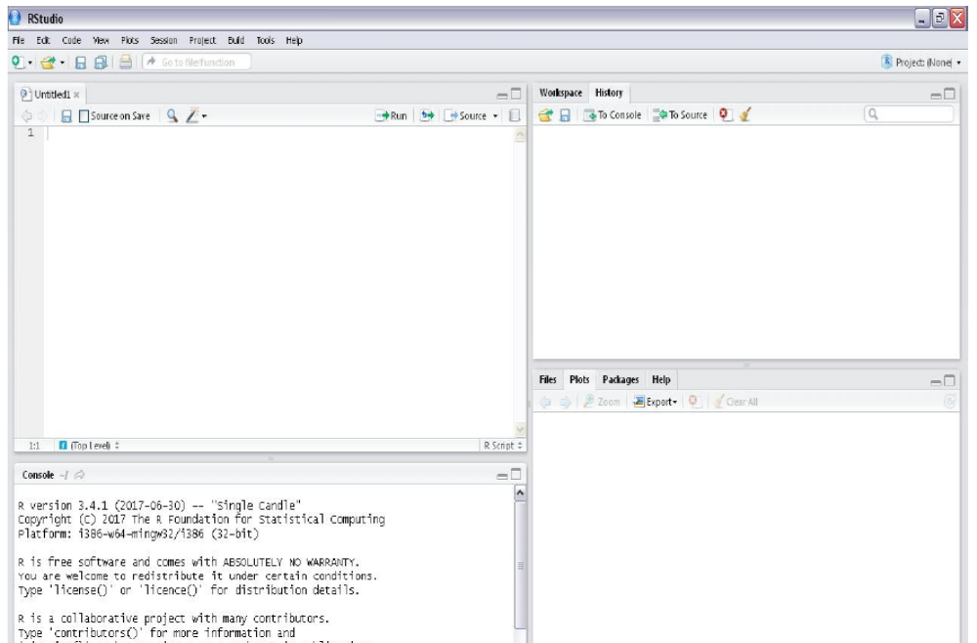
rstudio

Slide 23
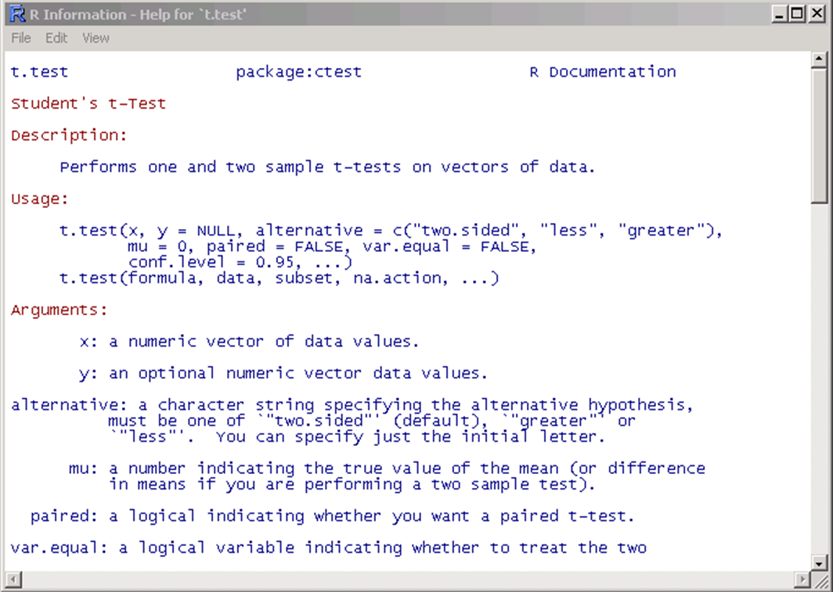
Getting help
Details about a specific command whose name you know (input arguments, options, algorithm, results):
>? t.test
or
>help(t.test)

Slide 24
Data types in R
The fundamental data type in R is the vector
  Null (empty object): Null
  Logical (Boolean): TRUE, FALSE or T, F
  Numeric (real number): 1,2,3, pi, 1e-5
  Complex(complex number): 2+i, 2i
  Character(chain of characters): “ABC”, “hi”
  In order to know the mode of an object, say x, in R we can use
> mode(data)

Slide 25
Vectors
Use collect function or concatenate: c
Construction by sequence operator (seq)
Construction by rep function
Construction by scan function
Examples
> 1:10
> seq(1,10, by=3) # We can simply use seq(1,10,3)
> rep(1,6)
> rep(c(1,2,3,4), each=3)
> rep(c(1,2,3,4), 3)
> y<-rep("A", 10)
> LETTERS[seq( from = 1, to = 10 )]
> letters[seq( from = 1, to = 10 )]

Slide 26
which() and match()
which() Indices of a vector where the condition is TRUE
which.max() Location of the maximum element of a numeric vector
which.min() Location of the minimum element of a numeric vector
match() First position of an element in a vector
Example
> x<-c(4,7,2,12,9,0)
> which(x>4)
[1] 2 4 5
> which.max(x)
[1] 4
> x[which.max(x)] # Exact value of the maximum value
[1] 12
> y <- rep(1:5, times=5:1)
> match(1:5,y)
[1] 1 6 10 13 15

Slide 27
match function
The match function answers the question “Where do the values in the second vector appear in the first vector?”
> first<-c(5,8,3,5,3,6,4,4,2,8,8,8,4,4,6)
> second<-c(8,6,4,2)
> match(first,second)
[1] NA 1 NA NA NA 2 3 3 4 1 1 1 3 3 2
The first thing to note is that match produces a vector of subscripts (index values) and that these are subscripts within the second vector. The length of the vector produced by match is the length of the first vector (15 in this example). If elements of the first vector do not occur anywhere in the second vector, then match produces NA.

Slide 28
Testing Vector Equality
> x <- 1:3
> y <- c(1,3,4)
> x = = y
[1] TRUE FALSE FALSE
> identical(x,y)
[1] FALSE
Note that “:” produces integers while “c()” produces floating-point numbers.
> x=c(1,2,3); y=1:3
[1] 1 2 3
[1] 1 2 3
> identical(x,y)
[1] FALSE
> typeof(x)
[1] "double" # Double is same as numeric
> typeof(y)
[1] "integer"

Slide 29
Character Functions
substr(x, start=n1, stop=n2)
sub(“old”,”new”, x)
strsplit(x, “”)# Split the elements of character
> strsplit("abc", "")
[1] "a" "b" "c"
> strsplit("How are you?", "")
[1] "H" "o" "w" " " "a" "r" "e" " " "y" "o" "u" "?“
> toupper(“x")
> tolower(“x")

Slide 30
Data Preprocessing With R
The main preprocessing in any data sets includes
Dealing with missing data
Dealing with categorical data
Splitting the dataset into training and testing sets
Scaling the features

Slide 31
Missing Values
For a number of reasons, certain elements of data may not be collected during and experiment or study. In R, missing values are represented by the symbol NA (not available) but impossible values (e.g., dividing by zero) are represented by the symbol NaN (not a number) and Inf for infinity.
> var(5) # Variance of a single observation
[1] NA
> log(-2)
[1] NaN
Warning message:
In log(-2) : NaNs produced
> exp(1e10)
[1] Inf

Slide 32
Detecting Missing Value
> x<-c(1,2,3,4,5,6,7,8,4,5,7)
> is.na(x)
[1] FALSE FALSE FALSE FALSE FALSE FALSE FALSE FALSE FALSE
> y<-c(1,4,NA,6,9,NA,7)
> is.na(y)
[1] FALSE FALSE TRUE FALSE FALSE TRUE FALSE
>y<-c(1,4,NA,6,9,NA,7)
> any(is.na(y)) # checking if there is any missing value
[1] TRUE
>which (is.na(y)) # Which one is NA?
[1] 3 6 # Answer: the third one and sixth

Slide 33
Dealing with Missing Values
The user can specify if NA should be last or first in a sorted order by indicating TRUE or FALSE for the na.last argument.
>y<-c(1,4,NA,6,9,NA,7)
> sort(y, na.last = TRUE)
[1] 1 4 6 7 9 NA NA
na.omit and na.exclude returns the object with observations removed if they contain any missing values
> x <- c(88,NA,12,168,13)
[1] 88 NA 12 168 13
> y=x[!is.na(x)]
> y
[1] 88 12 168 13
> mean(x)
[1] NA
> mean(x, na.rm=T)
[1] 70.25
> mean(na.omit(x))
[1] 70.25

Slide 34
Loops and Repeats
The classic, Fortran-like loop is available in R. The syntax is a little different, but the idea is identical; you request that an index, i, takes on a sequence of values, and that one or more lines of commands are executed as many times as there are different values of i.
Here is a loop executed five times with the values of i from 1 to 5: we print the square of each value:
> for (i in 1:5) print(i^2)
> x=c("a","b","c", "d")
> for(i in 1:4){
+ print(x[i])
+}
> x<-0
> while(x<10){
+ print(x)
+ x<-x+1
+ }

Slide 35
String normalization
String normalization techniques are aimed at transforming a variety of strings to a smaller set of string values which are more easily processed. By default, R comes with extensive string manipulation functionality that is based on the two basic string operations: finding a pattern in a string and replacing one pattern with another.
The stringr package offers a number of functions that make some string manipulation tasks a lot easier than they would be with R's base functions. For example, extra white spaces at the beginning or end of a string can be removed using str_trim
>library(stringr)
>str_trim(" hello world ")
[1] "hello world"
>str_trim(" hello world ", side = "left")
[1] "hello world "
>str_trim(" hello world ", side = "right")
[1] " hello world"

Slide 36
Distance measure
> a=c(2,7,8)
> b=c(3,2,1)
> x=rbind(a,b)
> dist(x, method = "euclidean")
a
b 8.660254
=========================================
> library("philentropy")
> distance(x, method = "euclidean")
Metric: 'euclidean'; comparing: 2 vectors.
euclidean
8.660254
> distance(x, method = "manhattan")
Metric: 'manhattan'; comparing: 2 vectors.
manhattan
13

Slide 37
Normalizing (Standardizing) and Rescaling Data
> scale(variable)#z-scores will be computed
> x=c(0,2,4,6,6,8,10,12)
> scale(x)
########minmax normalization
> scale(x, center=min(x), scale=max(x)-min(x))
OR
> library(scales)
> rescale(variable)#rescaling each variable to a [0,1] scale

Slide 38
Entropy
The entropy quantifies the expected value of the information contained in a vector
> library(DescTools)
> x=c(1,2)
> Entropy(x)
[1] 0.9182958

Slide 39
.
Whenever we introduce randomness, we also should set a random seed to make our R
code reproducible.
> set.seed (1234)
Use the set.seed function when running simulations to ensure all results, figures, etc are reproducible.
>x=sample(c("H","T"), 10, replace=T)
>flips <- sample(c("heads", "tails"), size = 500, replace = TRUE)
Two dice
twodice <- c()
for (i in 1:6) {
for (j in 1:6){
twodice <- c(twodice, (i+j))
}
}
twodice
library(TeachingDemos)
plot.dice( expand.grid(1:6,1:6), layout=c(6,6) )
# 10 rolls of 4 fair dice
>dice(10,4, plot.it=TRUE)

Slide 40
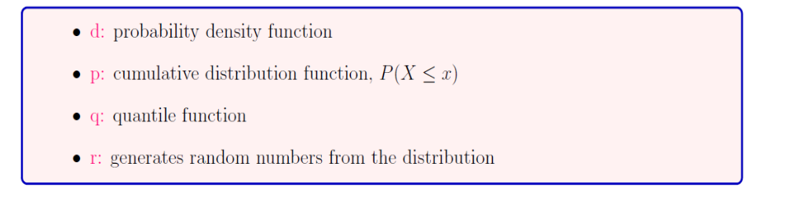
Probability Distributions
R supports a large number of distributions. Usually, four types of functions are provided for each distribution:

Slide 41
Data splitting
Assign probability of choosing data with certain characteristics
s = sample(row.names(data), 5, prob = ifelse(data$variable>value, 0.9, 0.01))
> data=read.csv("C:\\Aryal\\Data\\housing.csv")
> attach(data)
> names(data)
> View(data)
> library(tidyverse)
> data1=as_tibble(data)
> s <- sample(row.names(data), 5)
> s
[1] "3846" "1701" "1679" "2110" "3215"
> data[s,]
Assign probability of choosing data with certain characteristics
> s <- sample(row.names(data), 5, prob = ifelse(data$ROOMS>10, 0.9, 0.01))
> data[s,]

Slide 42
Data Splitting
partitioning into training (60%) and validation (40%)
train.rows <- sample(rownames(data), dim(data)[1]*0.6)
train.data <- data[train.rows, ]
valid.rows <- setdiff(rownames(data), train.rows)
valid.data <- data[valid.rows, ]
Note: alternative code for validation (works only when row names are numeric):
collect all the columns without training row ID into validation set
valid.data <- data[-train.rows,] # does not work for nonnumeric names

Slide 43
Dealing with Special Data
R package called rio (an acronym for R input and output).
It is capable of importing and exporting a large variety of file formats, including but not limited to: tab-separated (.tsv), comma-separated (.csv), JSON (.json), Stata (.dta), SPSS (.sav and .por), Microsoft Excel (.xls and .xlsx), Weka (.arff), and SAS (.sas7bdat and .xpt).
The rio package consists of three functions for working with proprietary data formats: import(), export(), and convert().
> library(rio)
> credit <- import("credit.csv")
> export(credit, "credit.xlsx")
> convert("credit.csv", "credit.dta")

Slide 44
Data Aggregating
It is relatively easy to collapse data in R using one or more BY variables and a defined function.
Example: Consider mtcars data from R and aggregate dataframe mtcars by cyl and vs, returning means
> attach(mtcars)
> aggdata <-aggregate(mtcars, by=list(cyl),FUN=mean, na.rm=TRUE)
> print(aggdata)
> aggdata2 <-aggregate(mtcars, by=list(cyl,am),FUN=mean)
> print(aggdata2)

Slide 45
Merging
To merge two dataframes (datasets) horizontally, use the merge function. In most cases, you join two dataframes by one or more common key variables (i.e., an inner join).
merge two dataframes by ID
total <- merge(dataframeA,dataframeB,by="ID")
merge two dataframes by ID and State
total <- merge(dataframeA,dataframeB,by=c("ID",“State"))
To join two dataframes (datasets) vertically, use the rbind function. The two dataframes must have the same variables, but they do not have to be in the same order.
total <- rbind(dataframeA, dataframeB)

Slide 46
Data binning
Binning or discretization is the process of transforming numerical variables into categorical counterparts. An example is to bin values for Age into categories such as 20-39, 40-59, and 60-79. Numerical variables are usually discretized in the modeling methods based on frequency tables (e.g., decision trees). Moreover, binning may improve accuracy of the predictive models by reducing the noise or non-linearity. Finally, binning allows easy identification of outliers, invalid and missing values of numerical variables.
Types of binning
Unsupervised binning methods transform numerical variables into categorical counterparts but do not use the target (class) information. Equal Width and Equal Frequency are two unsupervised binning methods.
Supervised binning methods transform numerical variables into categorical counterparts and refer to the target (class) information when selecting discretization cut points. Entropy-based binning is an example of a supervised binning method.

Slide 47
Data Binning
Binning refers to dividing a list of continuous variables into groups. It is done to discover set of patterns in continuous variables, which are difficult to analyze otherwise.
Binning leads to loss of information and loss of power. Once the bins are created, the information gets compressed into groups which later affects the final model. Hence, it is advisable to create small bins initially.
We could perform both automatic and manual binning. Example of automatic binning
> library(ggplot2)
> data(state.x77)
> data <- data.frame(state.x77)
> qplot(y = Frost, data = data, colour = 'blue')
> bins <- cut(data$Frost, 3, include.lowest = TRUE)
> bins <- cut(data$Frost, 3, include.lowest = TRUE, labels = c('Low','Medium','High'))
> bins
> plot(bins)

Slide 48
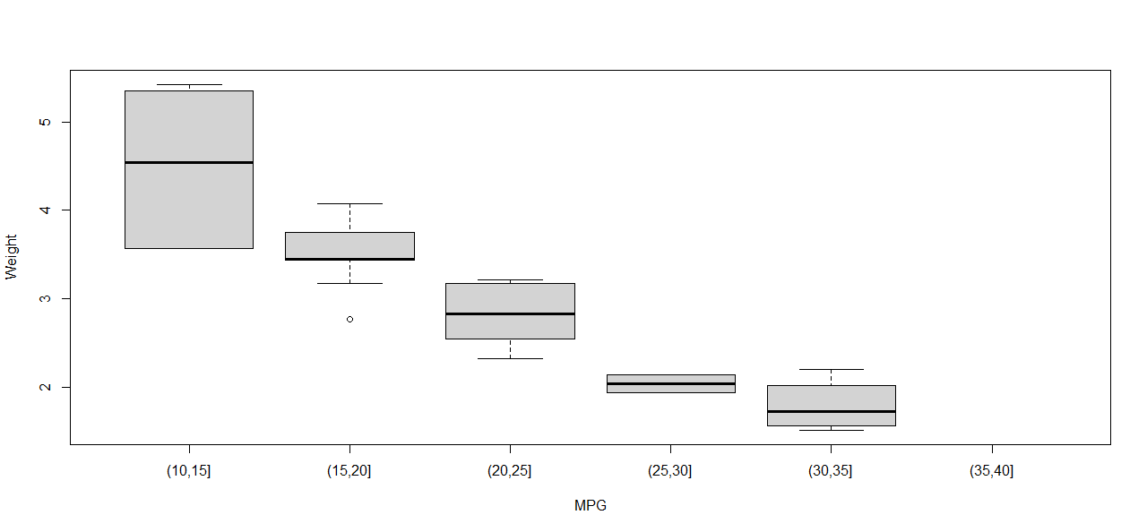
Example- Manual binning
> data(mtcars)
> mpgbins = cut(mtcars$mpg,breaks=c(10,15,20,25,30,35,40))
> boxplot(mtcars$wt~mpgbins,xlab="MPG",ylab="Weight")

Slide 49
Supervised Binning
In Supervised binning, the target variable i.e. the class variable is also taken into consideration while making bins for the continuous variable. In R, we will use a function called woe.binning which will perform supervised binning.
library(woeBinning)
Gender=c("M","F","M","M","M","F","F","F","M","F")
Age=c(22,24,23,26,28,32,35,38,40,42)
data=data.frame(Gender,Age)
View(data)
data1=woe.binning(data,"Gender","Age")
View(data1)
datanew=woe.binning.deploy(data,data1)
View(datanew)

Slide 50
Functions for calculating summary statistics of vector elements
min(): the minimum value of the numeric vector
max(): the maximum value of the numeric vector
range(): the range of the numeric vector
mean(): the arithmetic mean of the numeric vector
median(): the median of a numeric vector
quantile(): various sample quantiles of a numeric vector
IQR(): the inter-quartile range of a numeric vector
fivenum(): Tukey's five-number summary
sd(): the standard deviation of a numeric vector
var(): the variance of a numeric vector
pmin(): the parallel minima of two or more numeric vectors
pmax(): the parallel maxima of two or more numeric vectors
weighted.mean(): the weighted mean of a numeric vector
mad(): the median absolute difference of a numeric vector
rank(): the sample ranks of the values of a vector
cor(): the correlation between two numeric vectors or matrices
cov(): the covariance between two numeric vectors or matrices
density(): stats the kernel density estimates of a numeric vector

Slide 51
Thank you

